Slide 1
ASIC II OpenSPARC Final Presentation
Presented By Sean Zarzycki, Abesh Dhuka, David Herbert

Slide 2
INTRODUCTION
Last time…
Finished DC complier part for 90NM
Started to work on bonus part of the project
This time…
Finished ICC Complier part for 90NM
Finished ICC Complier part for FPU Array

Slide 3
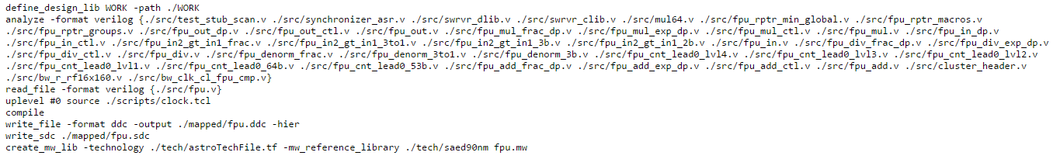
90NM ICC Complier Scripts
FIGURE 1: Run Single FPU Script
Divided Into 3 parts
Defining the files
Testing the design using the following parameters
333.333 MHZ Clock
.1 Transition
.1 derate
.2 latency
Writing the necessary files

Slide 4
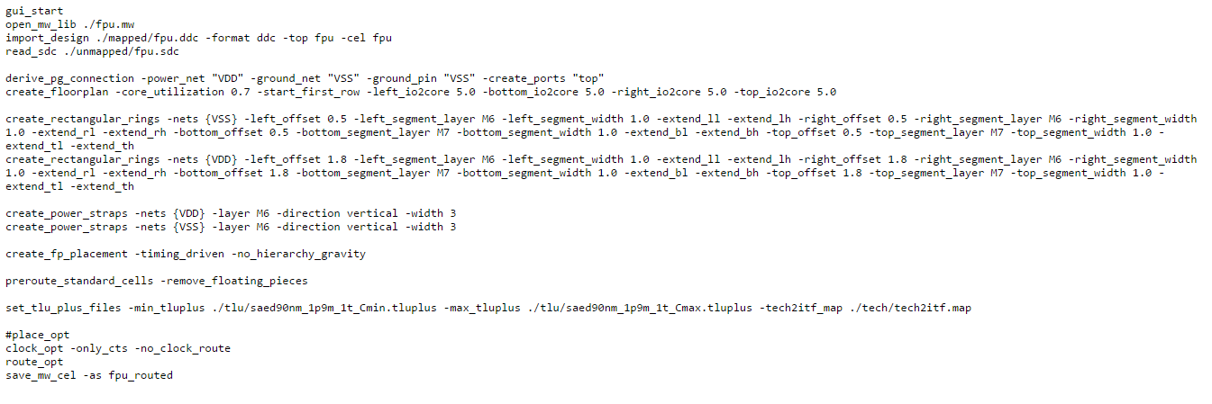
90NM ICC COMPLIER SCRIPTS (Contd)
FIGURE 2: FPU Floorplanning Script
Also divided into 3 parts
Setup
Floorplanning
Routing

Slide 5
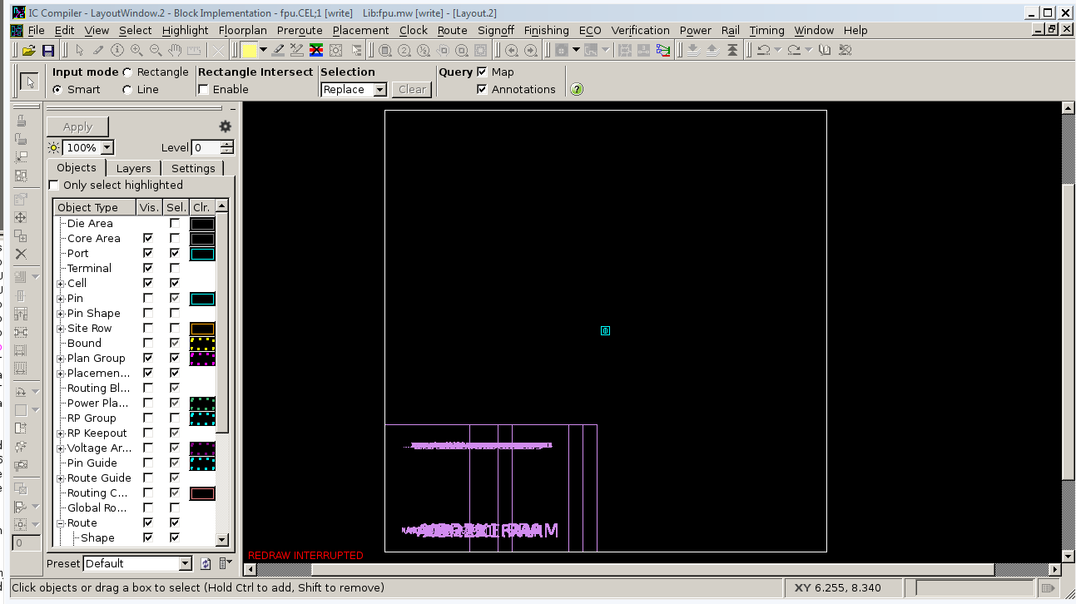
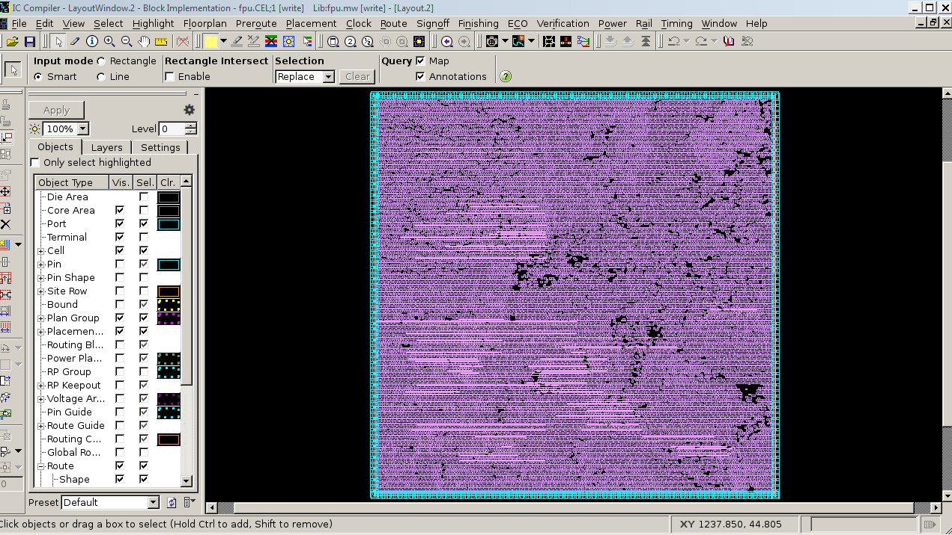
90NM Results
FIGURE 3 (LEFT): PRE ROUTING FIGURE 4(RIGHT): AFTER ROUTING

Slide 6
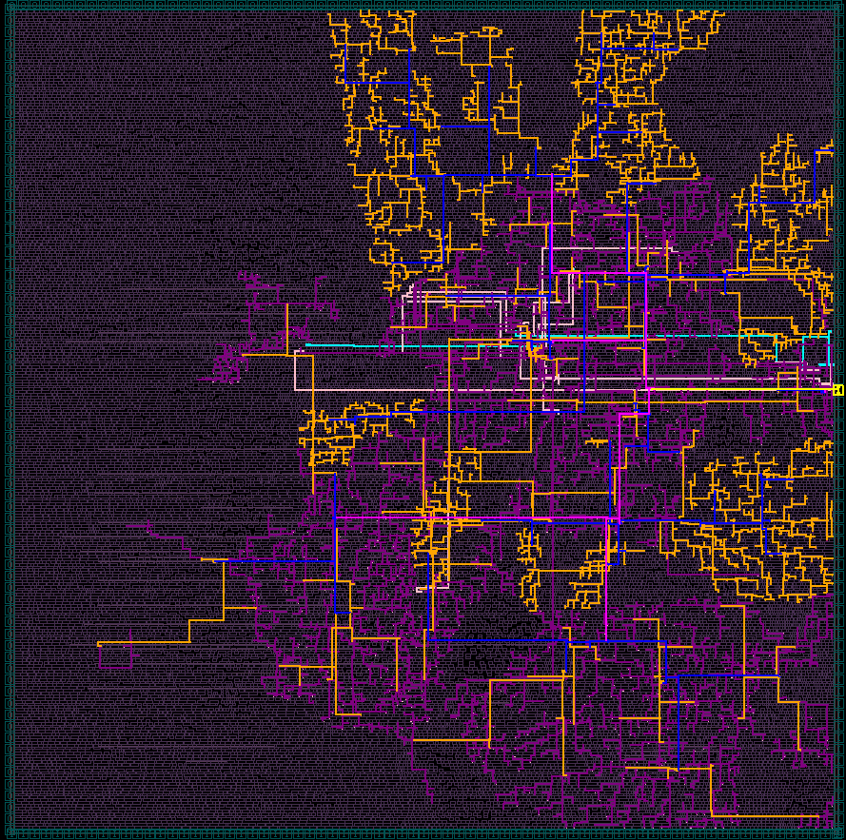
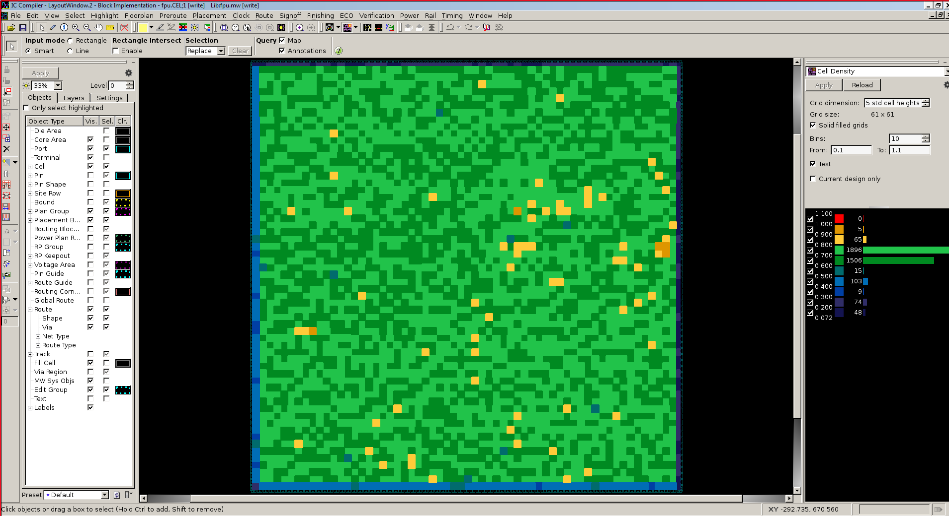
90NM Results
FIGURE 3 (LEFT): CLOCK TREE FIGURE 4(RIGHT): CELL DENSITY

Slide 7
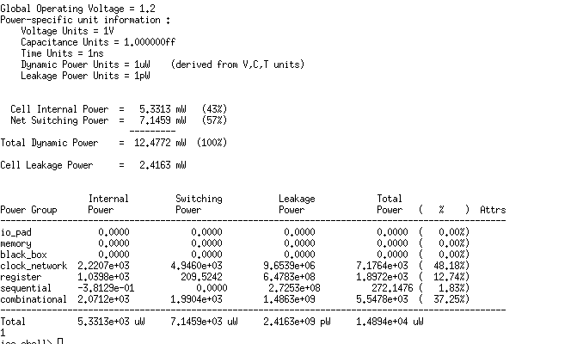
90NM Results
FIGURE 5: Power Results. Main takeaway is that total power is 1.4894e4 uW

Slide 8
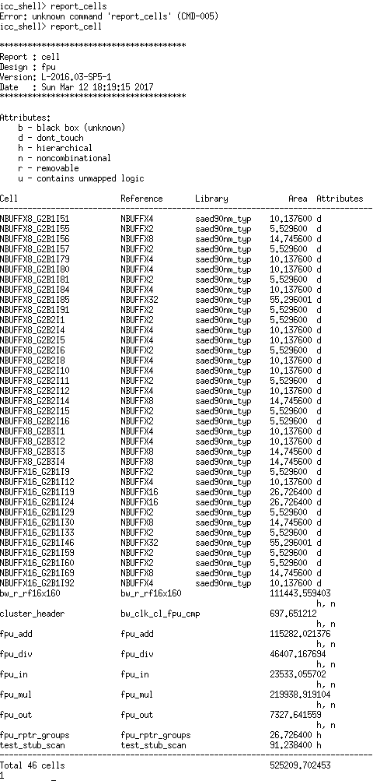
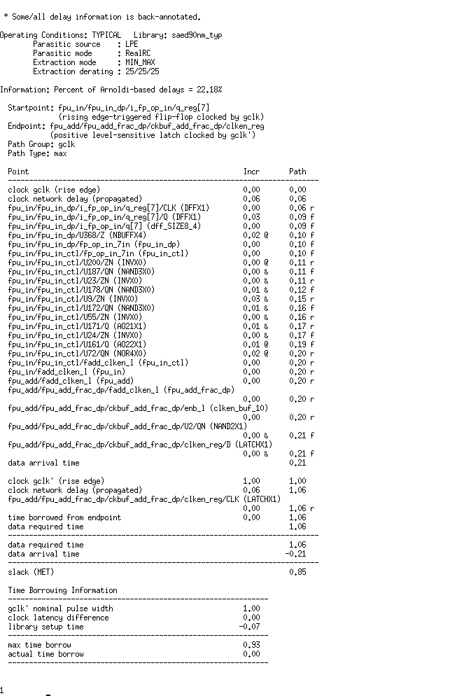
90NM Results
FIGURE 6 (LEFT): Area FIGURE 7(RIGHT):Timing

Slide 9
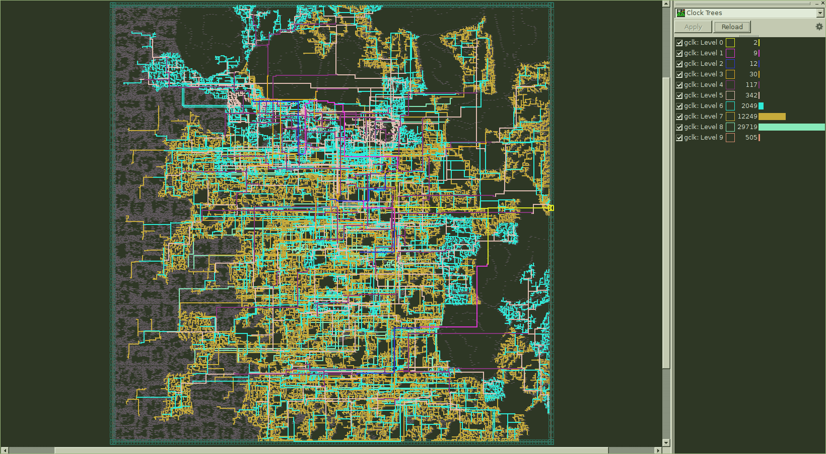
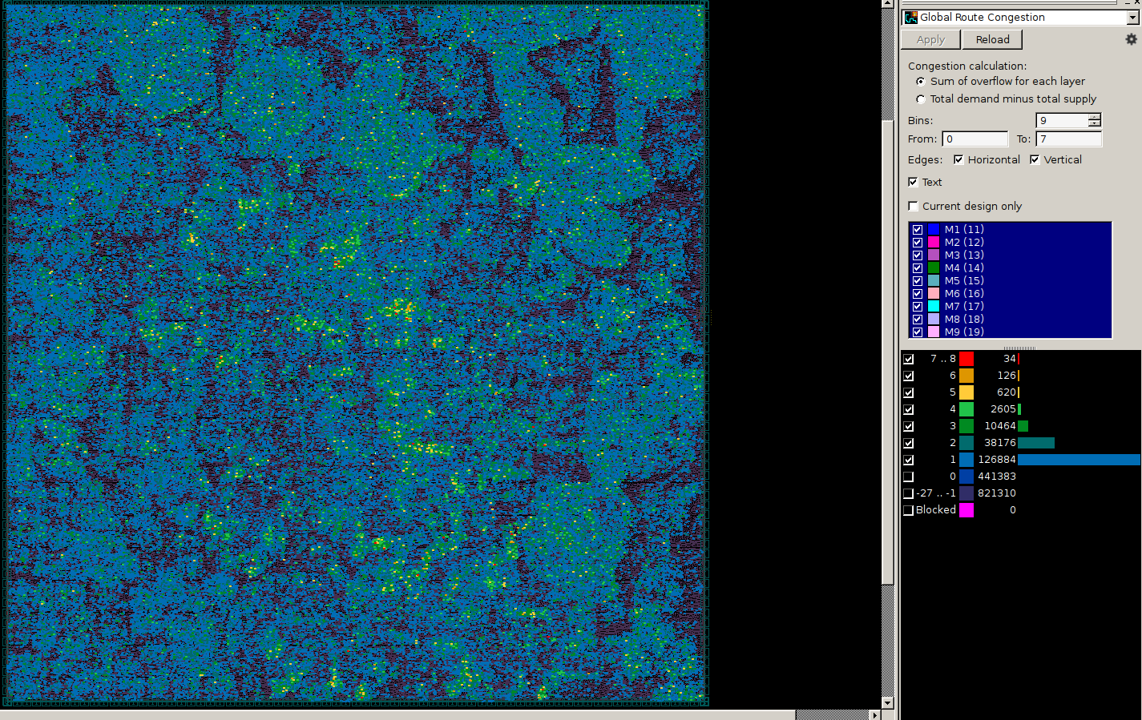
FPU Array Results
FIGURE 8 (LEFT): Clock Tree FIGURE 9 (RIGHT): Global Congestion Map

Slide 10
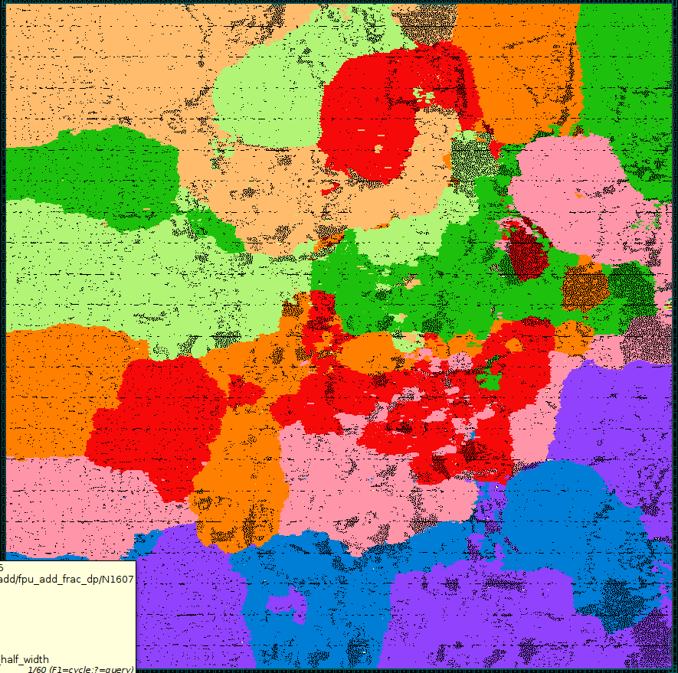
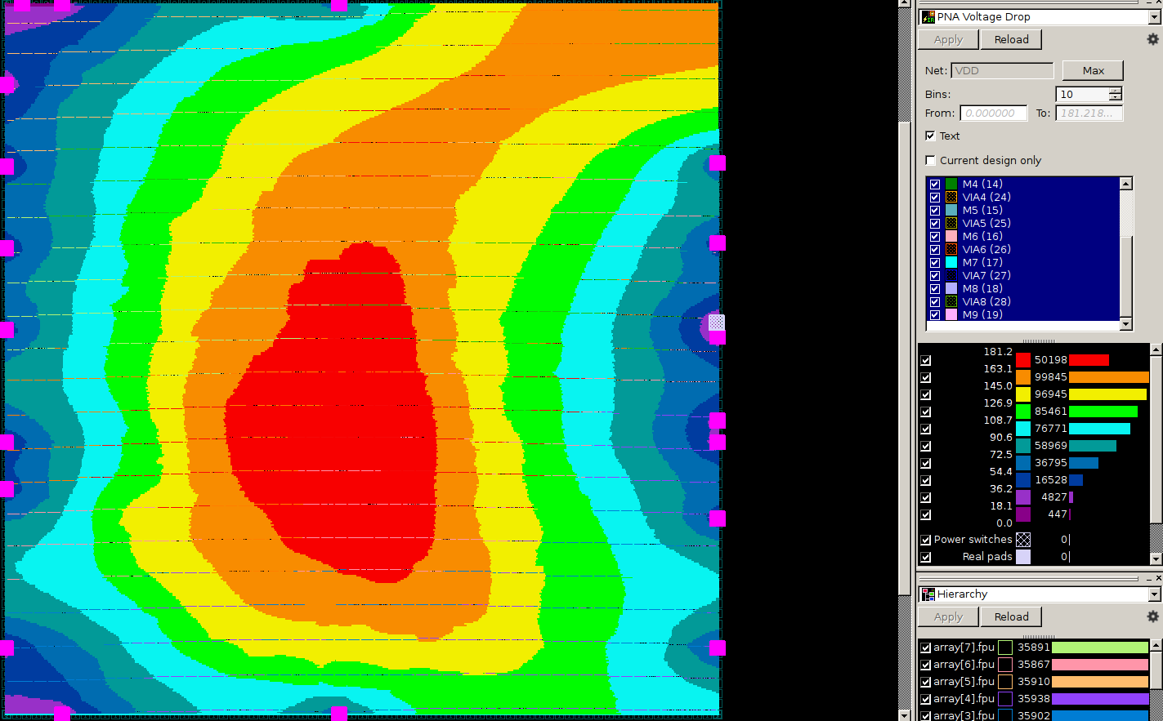
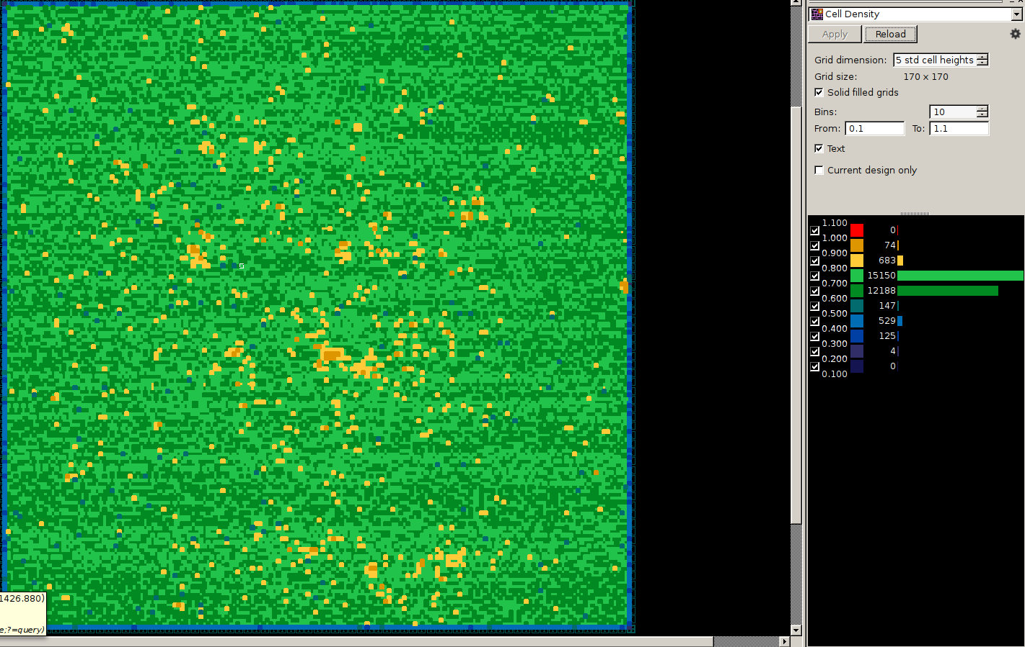
FPU Array Results
From Left to Right
Hierarchy (Figure 10)
Voltage Drop (Figure 11)
Cell Density (Figure 12)

Slide 11
Conclusion
Pretty Content with ICC Results
Things left to do
Primetime testing
32NM and 45NM work (If time is available!)
QUESTIONS?
THANK YOU FOR PAYING ATTENTION TO THIS PRESENTATION!

